Slide 1
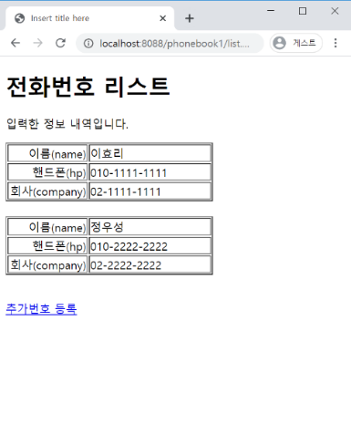
phonebook2 개요 및 분석
01
분석-삭제
Tomcat
http://localhost:8088/phonebook2/pbc?action=delete&id=23
phonebook2
Rquest
파라미터
action=delete&id=23
리다이렉트 코드
Contoller
(servlet)객체
Dao 객체
Rqeust(요청)
PersonDelete()
Rqeust(요청)
delete일때
//삭제처리
//리다이렉트
Request header
파라미터: action=delete
Request body
response
Response(응답)
Response(응답)
Response header
Response body
(html)
DB
http://localhost:8088/phonebook2/pbc?action=list

Slide 2
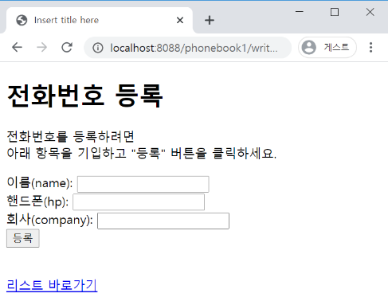
phonebook2 개요 및 분석
01
분석-수정폼
Rquest
파라미터
action=updateForm&id=1
Tomcat
http://localhost:8088/phonebook2/pbc?action=updateForm&id=1
phonebook2
Rqeust(요청)
Rqeust(요청)
contoller(servlet)객체
Request header
파라미터: action=updateForm&id=1
Request body
updateForm일때
if("uform".equals(action))
response
rquest
*포워드
updateForm.jsp
객체
response
Response(응답)
Response(응답)
Response header
Response body
(html)

Slide 3
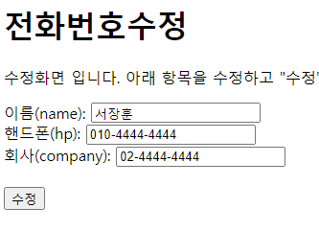
phonebook2 개요 및 분석
01
분석-수정
Rquest
파라미터
action=update&name=최원호&hp=010-2222-2222&company=02-2222-2222
http://localhost:8088/phonebook2/pbc?action=update&name=최원호&hp=010-2222-2222&company=02-2222-2222
Tomcat
phonebook2
Rqeust(요청)
contoller(servlet)객체
phoneDao 객체
update일때
personUpdate
if ("update".equals(action))
PersonUpdate()
Rqeust(요청)
response
Request header
파라미터: action=update&name=최원호&hp=010-2222-2222&company=02-2222-2222
Request body
Response(응답)
Response(응답)
DB
Response header
Response body
리다이렉트(리스트)

